Slide 1
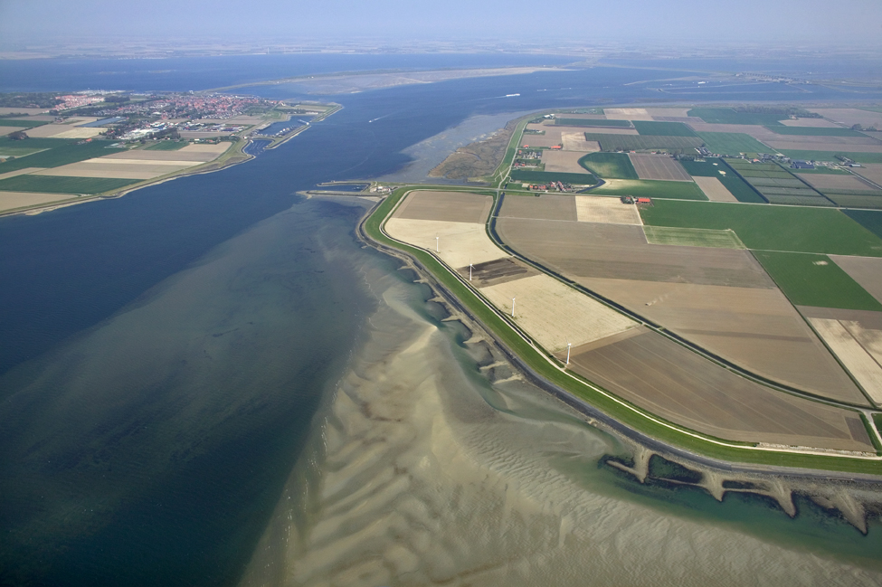


Visualisation of data in FEWS

Slide 2
Visualisation
Data import
Pre-processing (transformations)
Visualisation of data in Delft-FEWS
Pre-adapter
Run model
Post-adapter
Post-processing
Visualisation

Slide 3
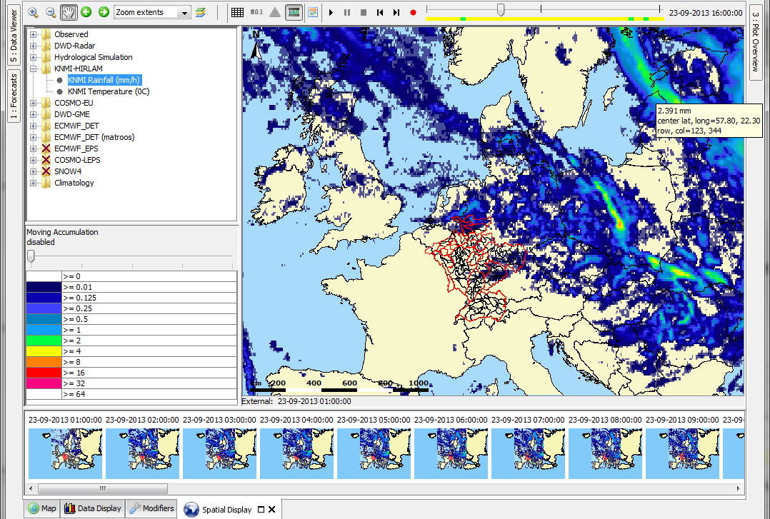
Spatial / Grid Display

Slide 4
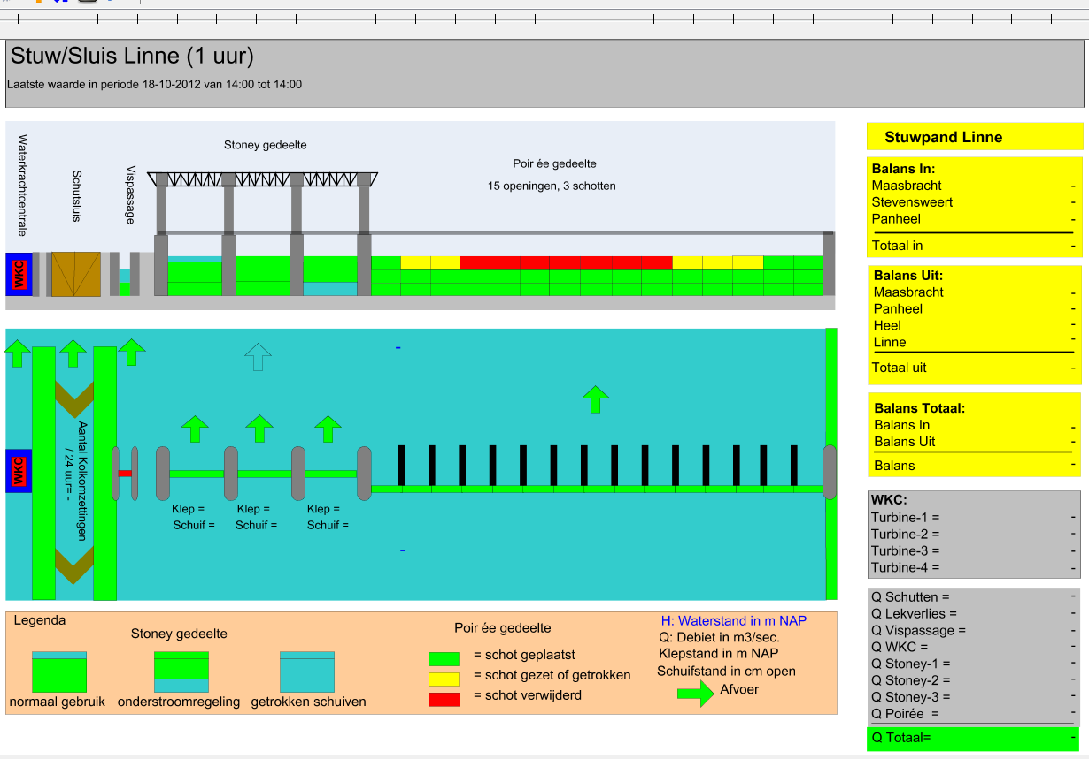
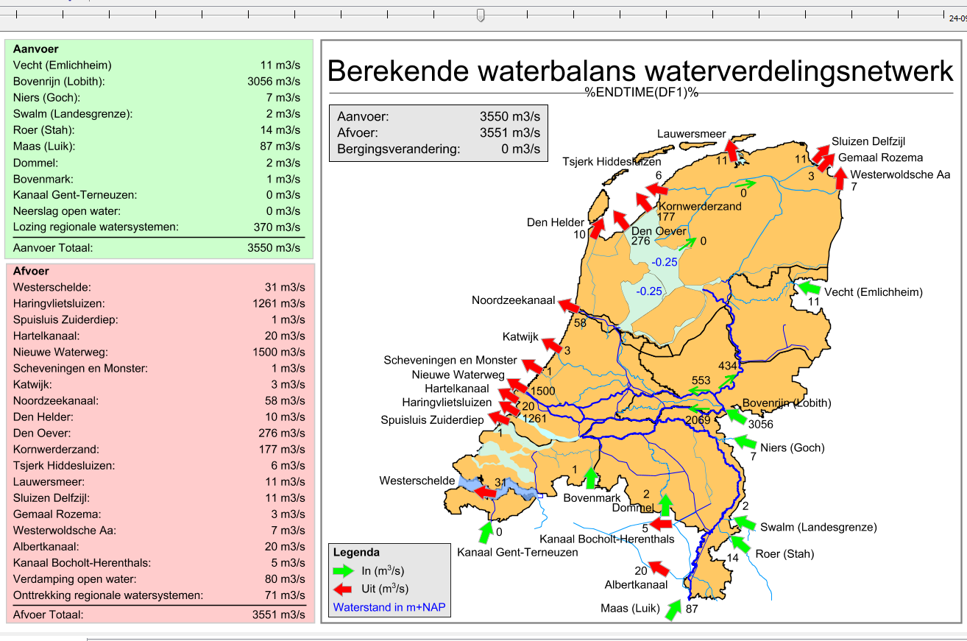
Schematic Status Display

Slide 5
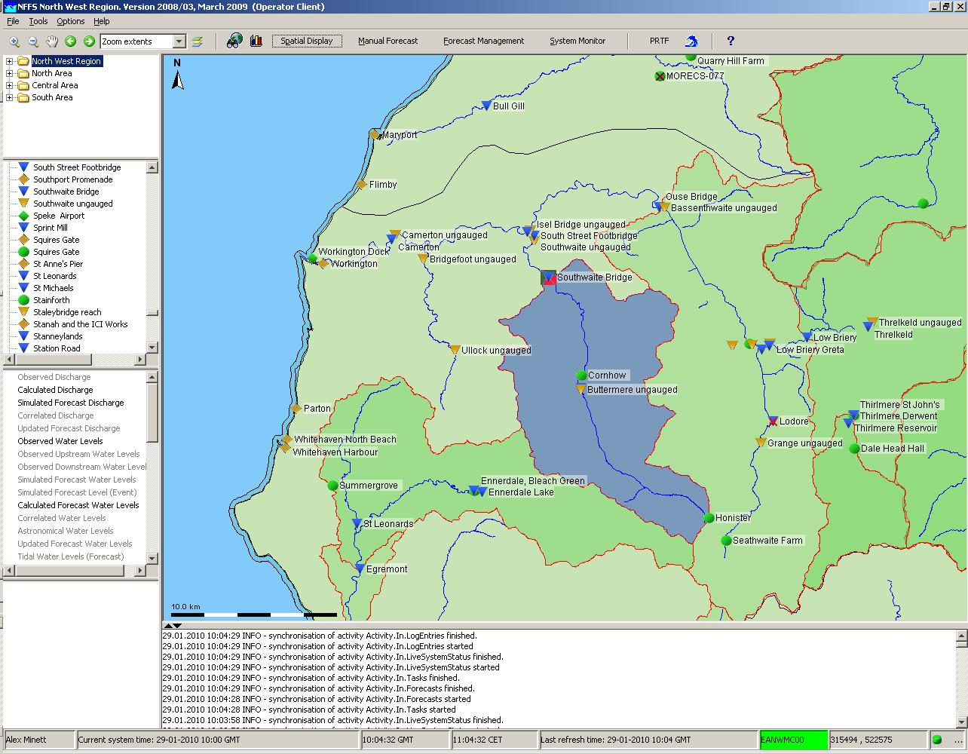
Display of data - Filters
Demonstration

Slide 6
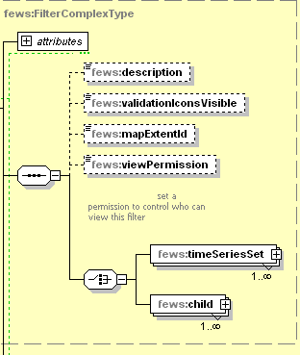
Display of data – Filter configuration
Filters are used to define the:
locations displayed on the map
locations displayed in the list box
parameters displayed in the list box
Filter:
organised in folders with child filters
arrange time series sets in logical groups
import elements in the time series set
extra options
view permissions
validation icons visible
link to map extent

Slide 7
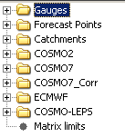
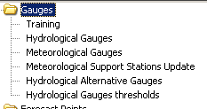
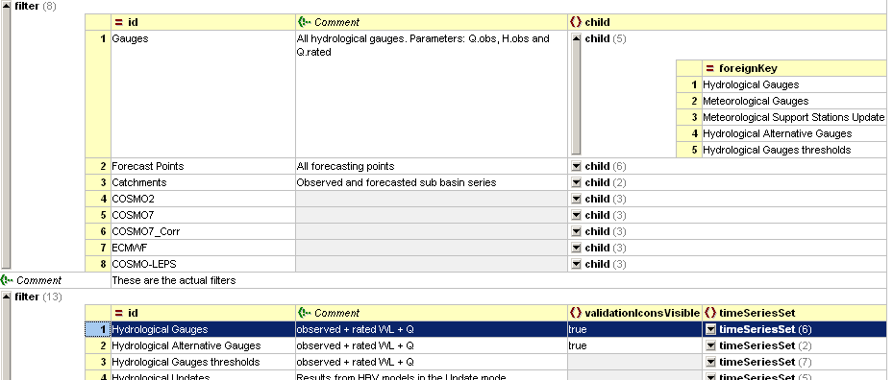
Display of data – Filter Configuration
child filter
organised in sub-folders (childs)

Slide 8
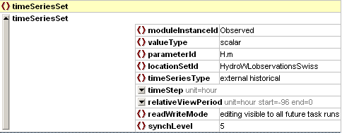
Display of data - Filters - Extra options
Relative View Period for Icon on main map
Allow/Disallow editing
synchLevel – for live system
(5 = edited data)

Slide 9
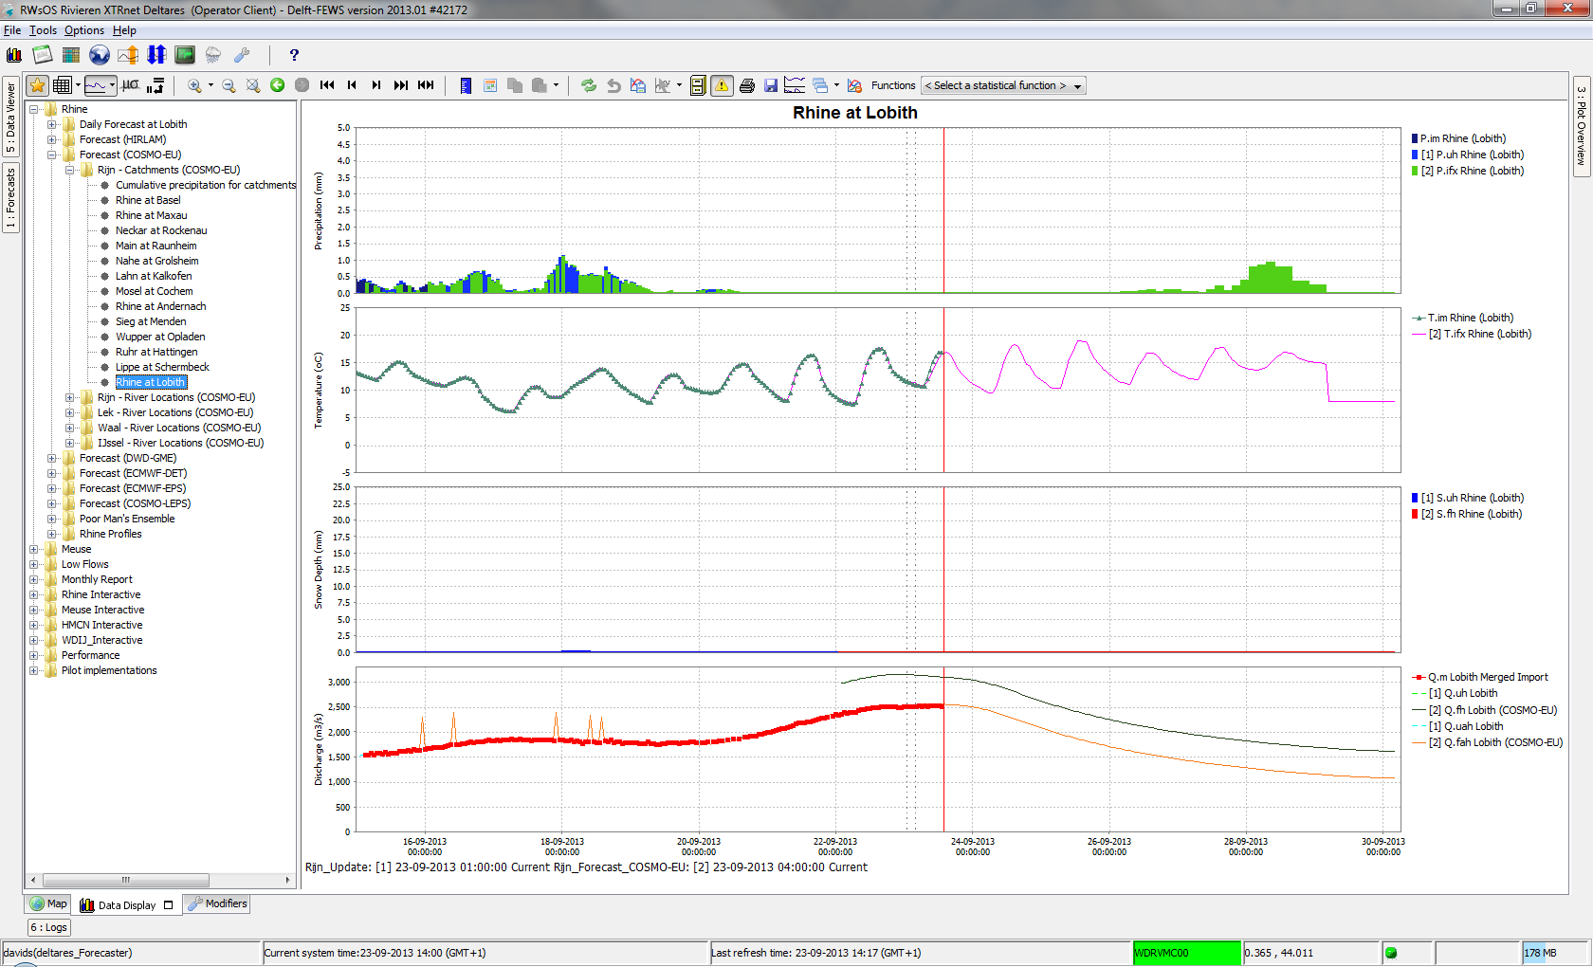
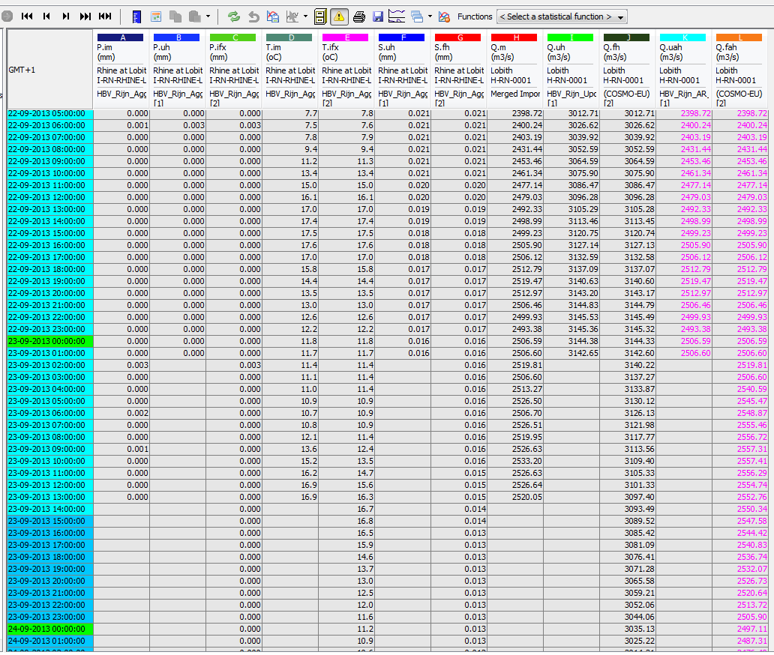
Time Series Display
Time Series Display is used to show data in a graph and in a table
Editing and viewing data
Pre-configured displays
Thresholds
Historic Events

Slide 10
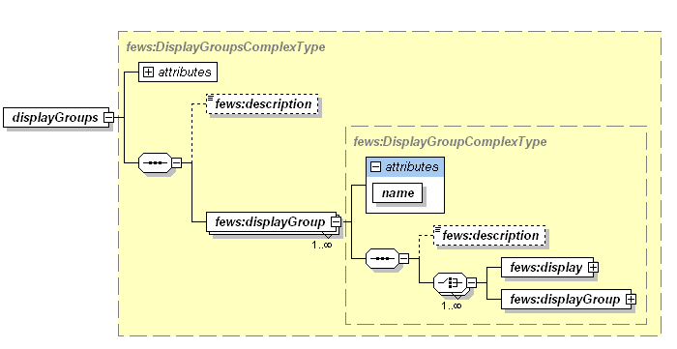
Time Series Display - Configuration
Time Series Display uses 4 configuration files
TimeSeriesDisplayConfig
Thresholds and ThresholdValueSets
DisplayGroups
HistoricalEvents
Display groups
are pre-defined displays
are used to create folder structure of displays
can be nested

Slide 11
Exercise
Exercise 8: Add pre-configured displays

